Slide 1







Classification of
Wisconsin Breast Cancer

Slide 2


About
Dataset
The Wisconsin Breast Cancer Dataset is a well-known binary classification dataset consisting of 569 samples with 30 numerical features.
This dataset is widely used in machine learning and medical research to evaluate classification models such as KNN, Decision Tree, Random Forest, SVM, and Naïve Bayes.
Source:
UCI Machine Learning Repository: https://archive.ics.uci.edu/ml/datasets/Breast+Cancer+Wisconsin+%28Diagnostic%29
Scikit-learn: https://scikit-learn.org/stable/datasets/toy_dataset.html

Slide 3


Table of
Content
Import Libraries
Load Dataset
Data Preprocessing
Exploratory Data Analysis
Data Splitting
Model Training
Feature Importance
Model Evaluation
Summary of Analysis and Conlusion

Slide 4
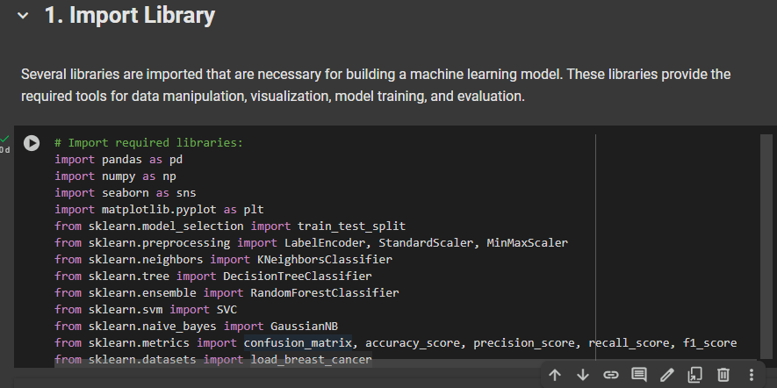



Import
Libraries

Slide 5

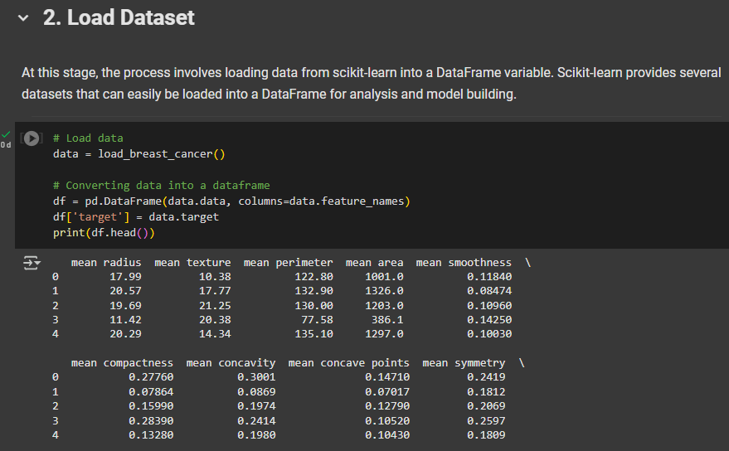

Load
Dataset

Slide 6

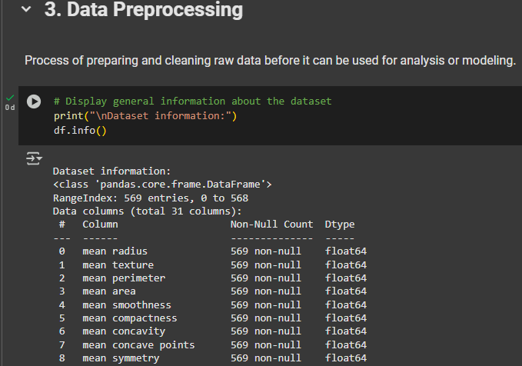
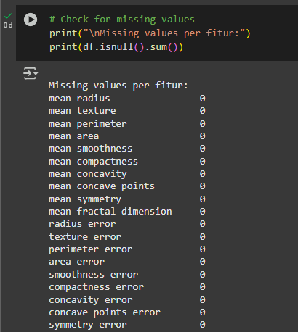

Data
Preprocessing

Slide 7
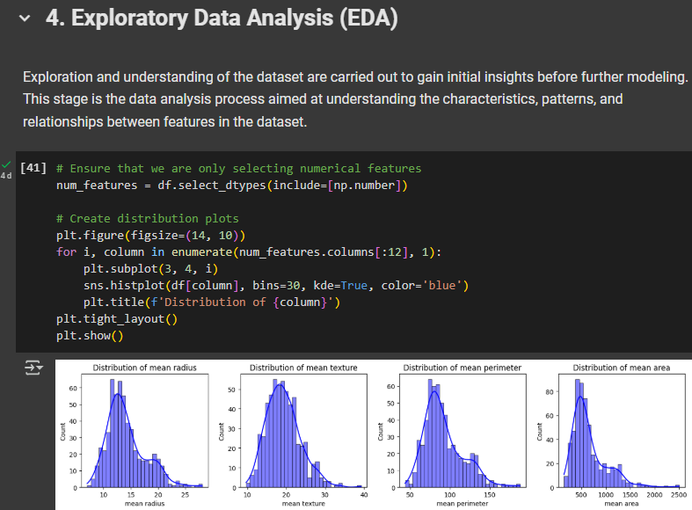
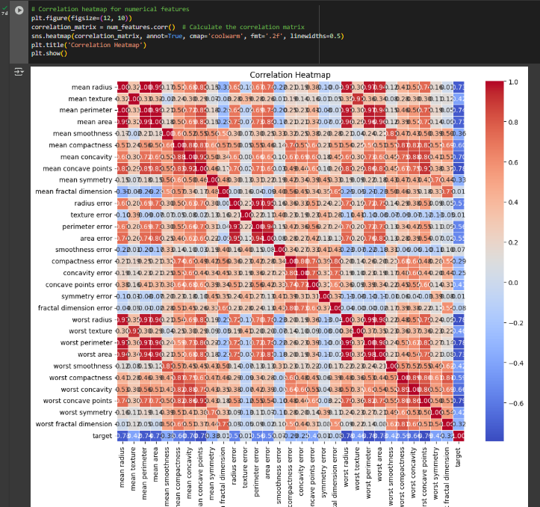
Exploratory
Data Analysis

Slide 8

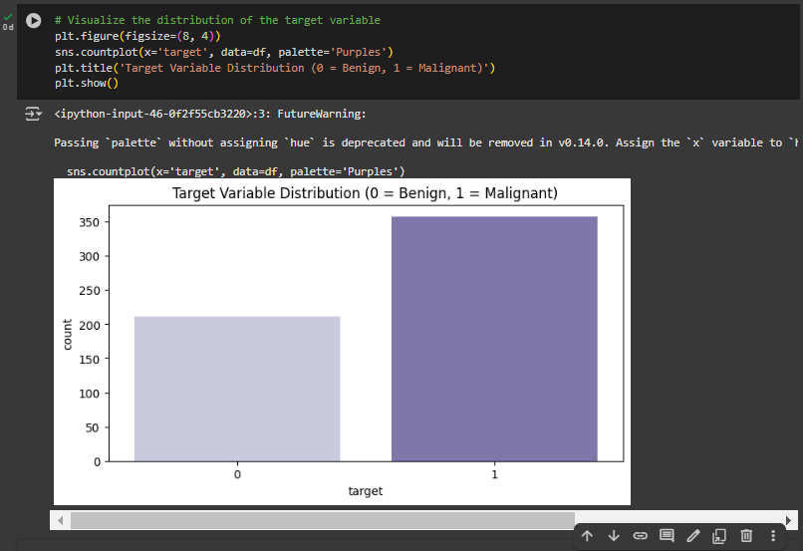
Exploratory
Data Analysis

Slide 9
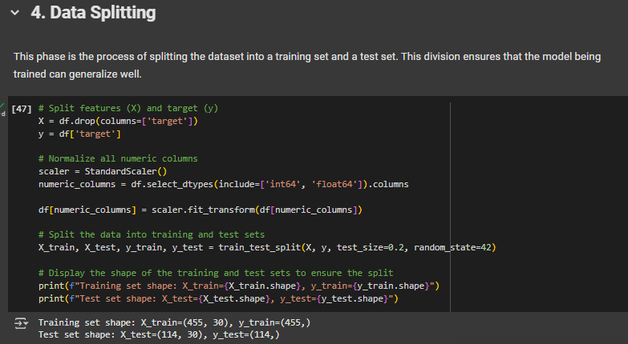

Data
Splitting

Slide 10
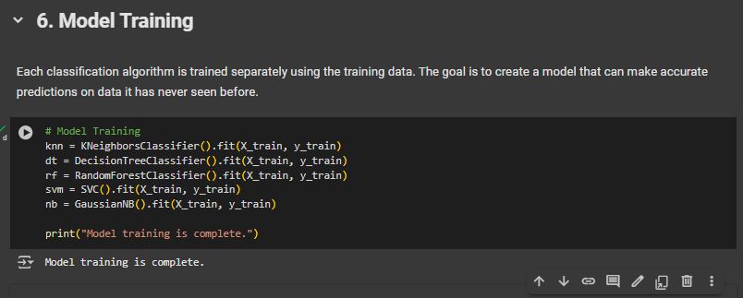

Model
Training

Slide 11

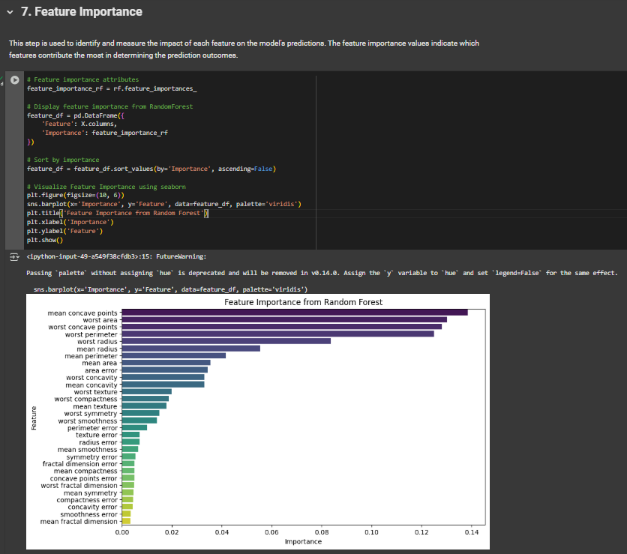
Feature
Importance

Slide 12
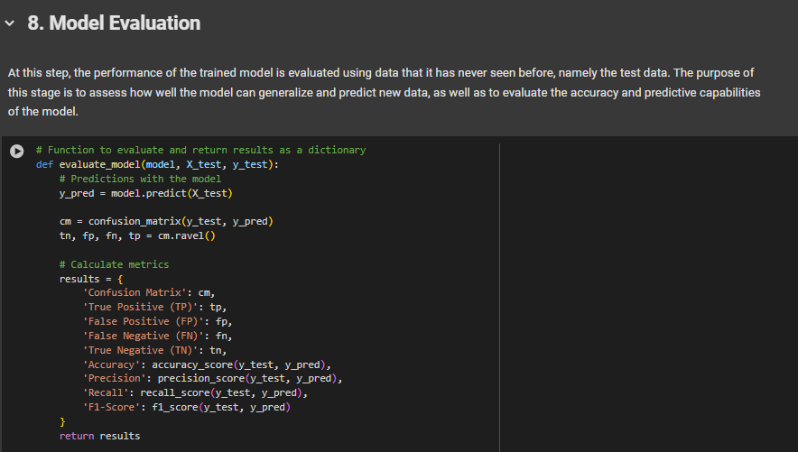
Model
Evaluation

Slide 13

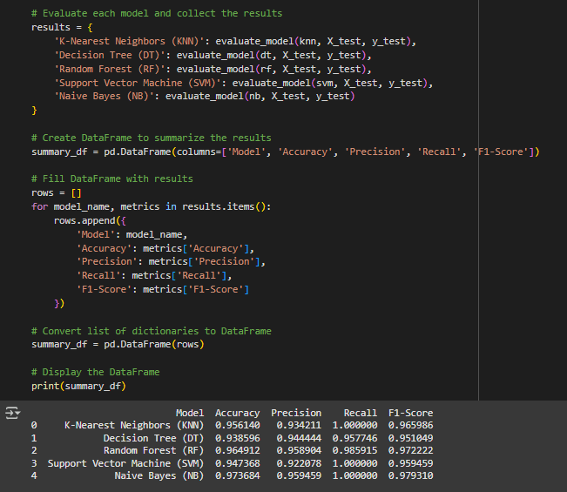
Model
Evaluation

Slide 14

Conclusion
Random Forest is the best model with the highest accuracy, precision, recall, and F1-Score.
Naive Bayes is also very good, while KNN and SVM have 100% recall but with a slight decrease in precision.
Decision Tree shows stable performance but is lower compared to the other models.

Slide 15







Tools
Used
Tailored Strategies
Page 3

Slide 16



Thank You

